Slide 1
Mr Chef Catering
Proposal

Slide 2
Fresh Food Suited To Your Business
Busy? Grab & Go!!
Chill with a Freshly made Tea or Coffee
Missed Breakfast? Fruit, Yoghurts or Muffins on the Go
Treat yourself to a Cake
Sit in with a Freshly made Rustic Baguette or Roll
Eat Healthy, Feel Healthy, build your own Salad

Slide 3
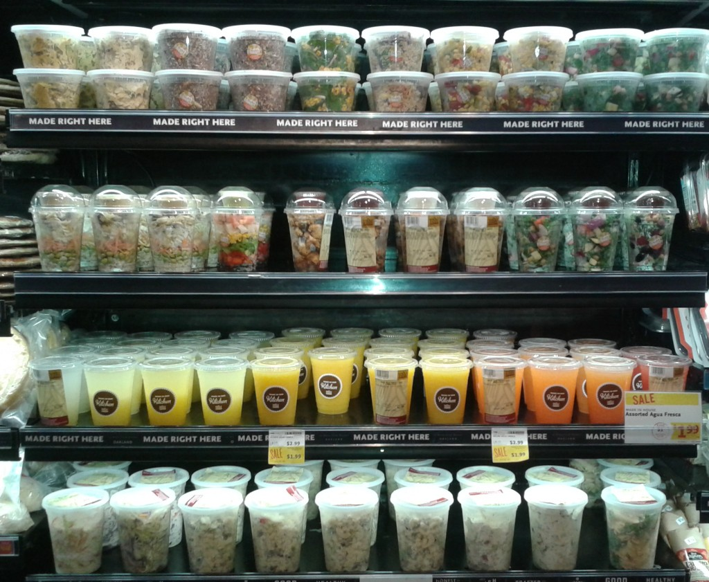
Grab and Go !
Assorted Sandwiches
Various Salad Boxes
Protein Pots
Flavoured Yoghurt Pots
Melon Pots
Grape Pots
Muffins & Cakes

Slide 4
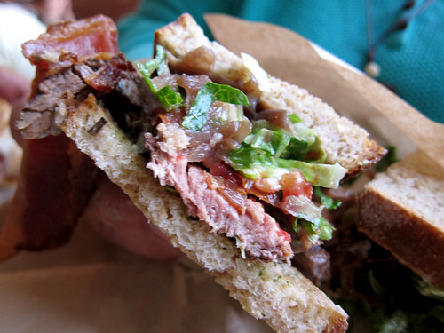
Premium Sandwiches (Made to Order)
Beetroot Bread, Multi seed Bread, Ciabatta & Many More..
Rare Beef
Honey Roast Ham
Brie, Goats cheese & Mozzarella (v)
Flavoured Chicken
Hummus (Ve)
Falafel, Onion Bhaji & Mint Yoghurt (v)
Flavoured Mayonnaises, Chutneys and Relishes
Salad items

Slide 5
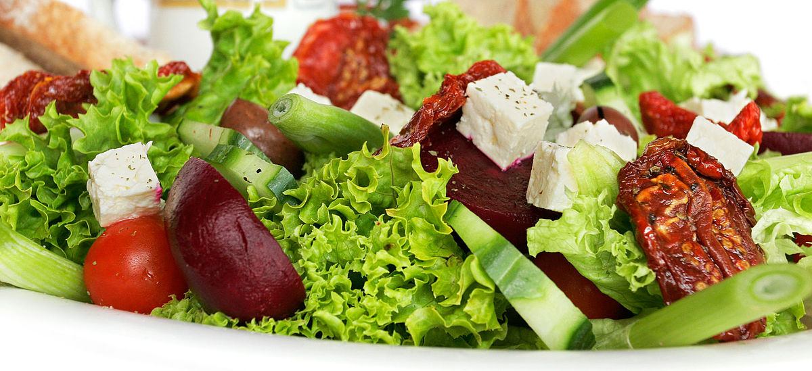
Salad Boxes
Tuna Niçoise
Chicken Caesar Salad
Caesar Salad (v)
Roasted Vegetable Salad (Ve)
Quinoa & Beetroot Salad (Ve)
Greek Salad (v)
Build Your Own Salad Box

Slide 6
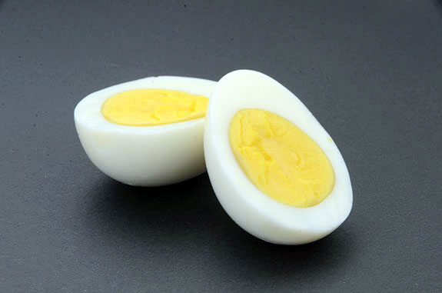
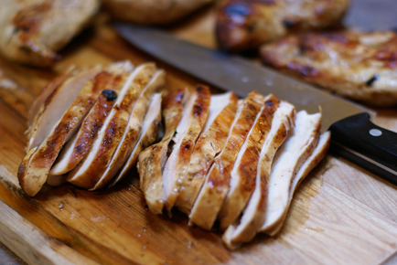
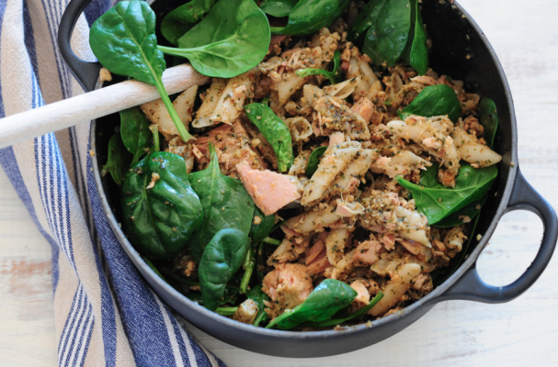
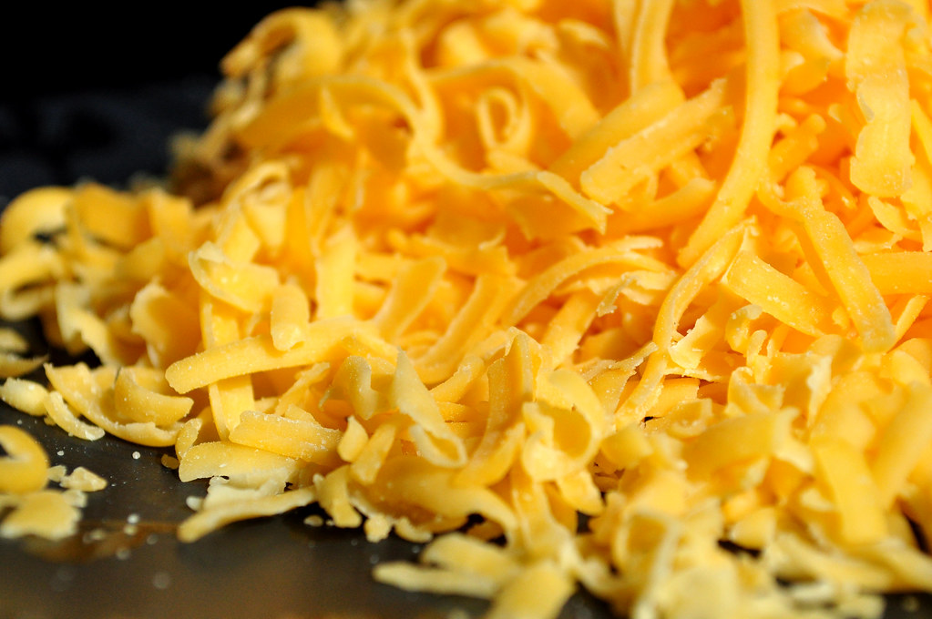
Protein Pots
Boiled Eggs
Tuna Mayonnaise
Mature Cheddar Cheese
Roast Chicken

Slide 7
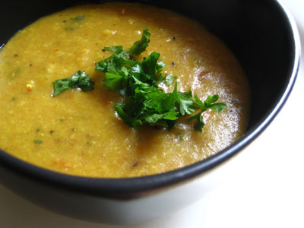
Freshly Made Soup
All Vegan Friendly
Butternut Squash & Chilli
Tomato & Basil
Leek & Potato
Spinach & Watercress
Sweet Potato & Thyme
Pea & Mint
Mulligatawny
Vegetable & Lentil

Slide 8
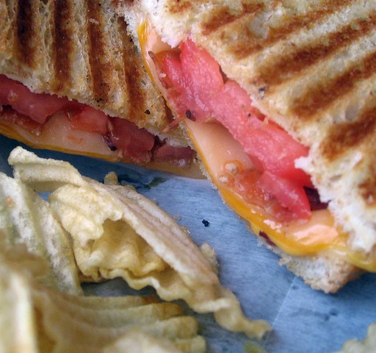
Panini’s Paninis & Toasties
Mozzarella, Pesto & Tomato (v)
Roasted Vegetable & Cheddar Cheese (v)
Tuna Melt
Chicken, Pesto & Goats Cheese
Ham, Tomato & Cheddar Cheese
Cheese & Red Onion (v)

Slide 9

Freshly Made Hot Drinks
Americano
Flat White
Cappuccino
Latte
Mocha
Tea
Specialty Tea’s

